Slide 1
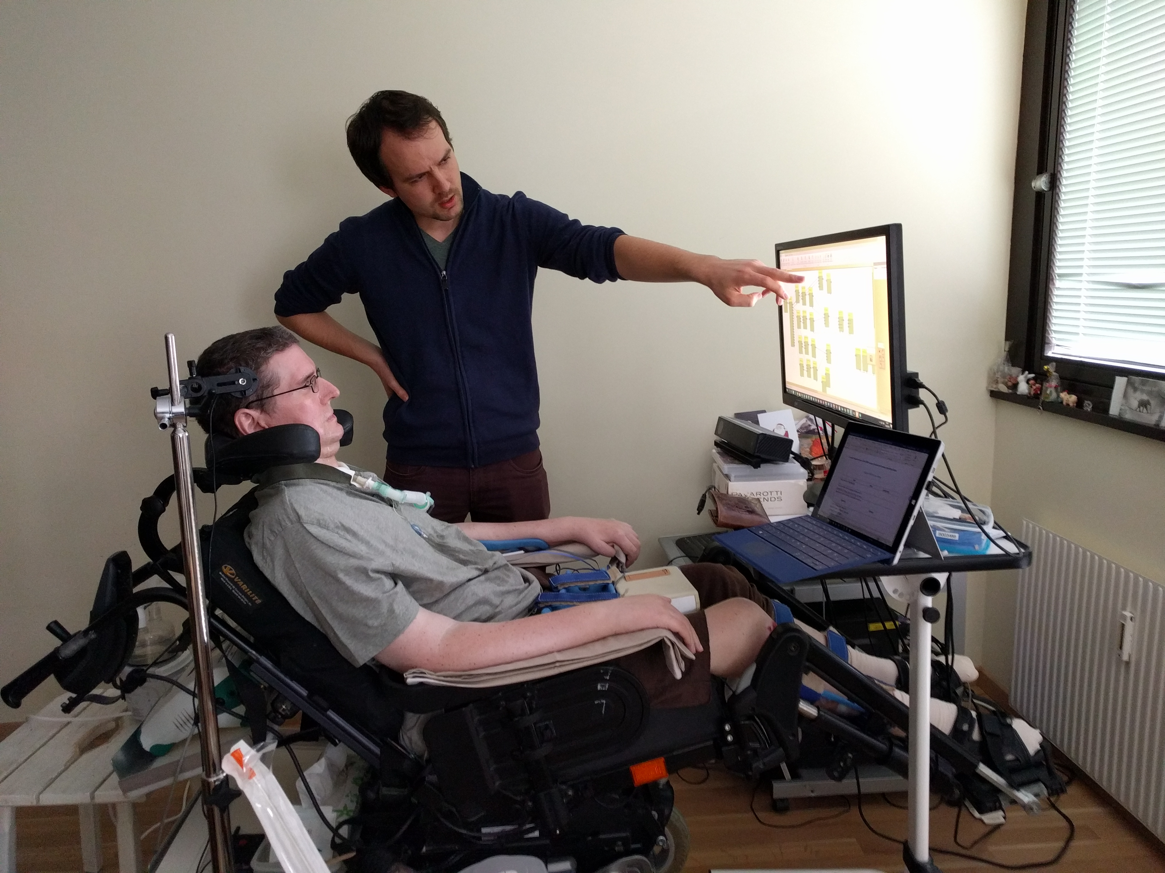

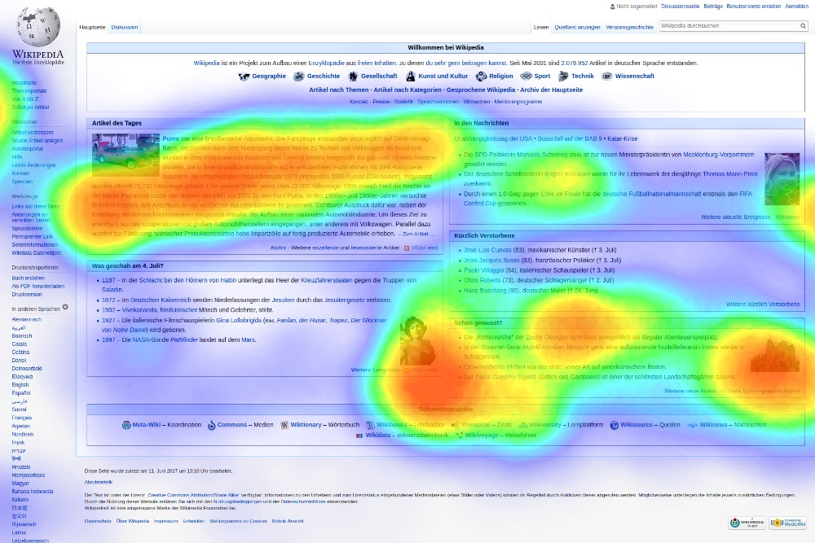
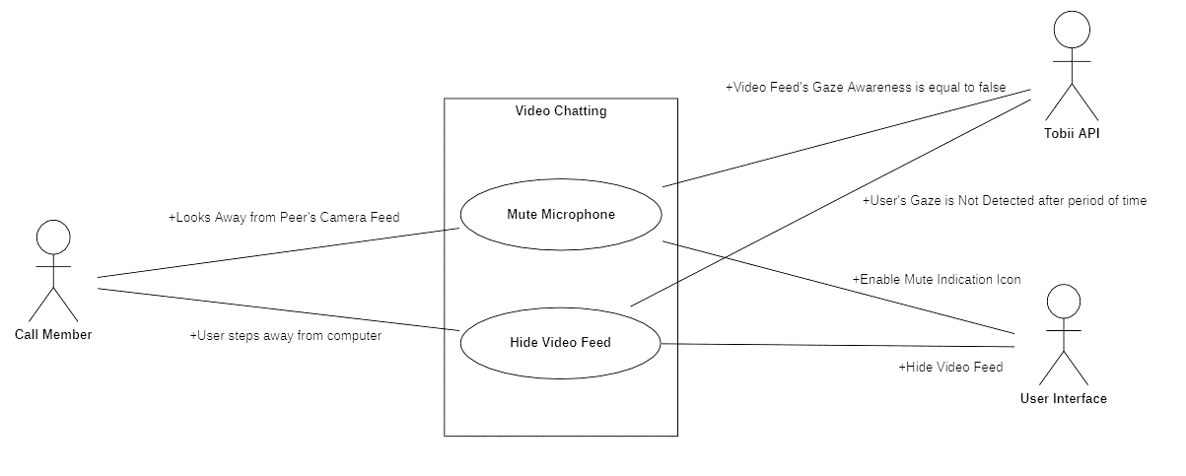

EYE-2-EYE:
Exploring How Eye-Tracking Can Improve Video Call Interactions for the Handicapped
Robson Basha | 100750867

Slide 2
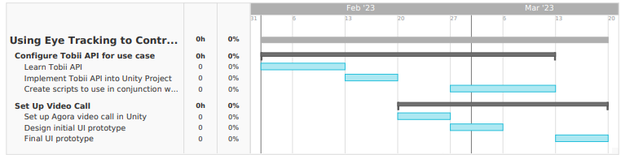
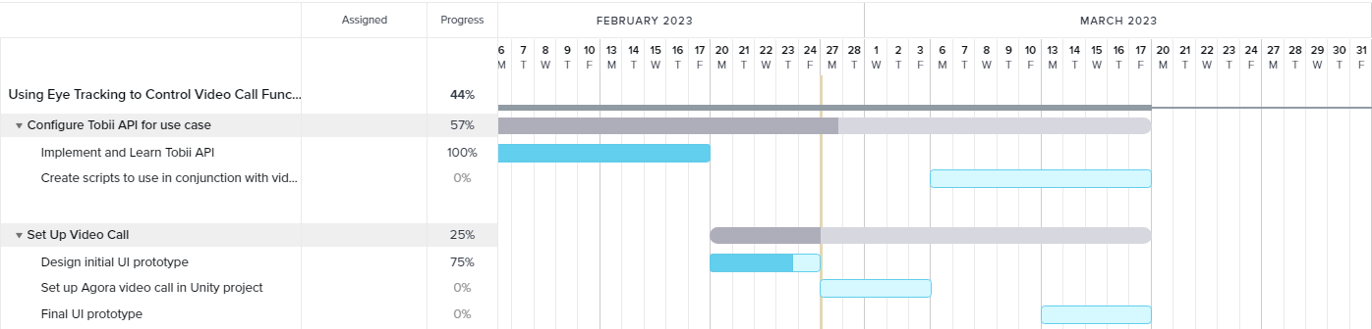
Appendix
Gantt Chart as of Assignment 1
Current Gantt Chart

